Slide 1
MG212: Marketing
Lecture 4
LSE - Fall 2017
Dr. Heather Kappes

Slide 2
Organisational notes
Summative assessment (group project) available on Moodle later today
Remember: groups of 3-4 within your assigned class
Must tell your class teacher about your group formation next week
Example (outstanding) projects from last year hopefully available on Moodle early next week
Questions about the project should be posted on the Moodle Forum (“Summative Assessment Questions & Answers”)

Slide 3
Who (which customers) are we going to serve? And how?

Slide 4
Outline
Overview: what are we doing and why?
Segmentation
What is it
How is it done
Targeting
What is it
How is it done
Why is it done
Positioning
What is it
Differentiation
How is it done
Perceptual maps
Recap

Slide 5
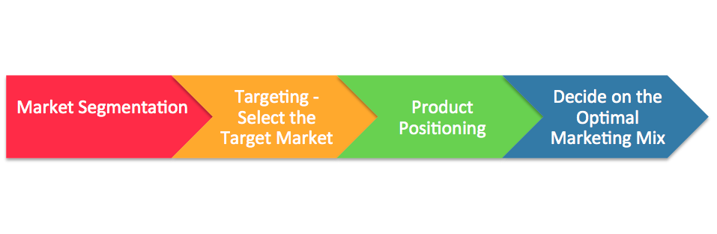
Segmentation, targeting, positioning
Undifferentiated → Differentiated
Overview → Segmentation → Targeting → Positioning → Recap

Slide 6
Segmentation
Q: What is it?
A: Separating prospective buyers into groups such that, within a group:
Similarity is high
Similarity between-groups is low
Needs are common
Responses to marketing action are similar
Overview → Segmentation → Targeting → Positioning → Recap
What is it → How is it done

Slide 7
Segmenting customers: Methods
What attributes are important? How important?
Obtain attribute importance ratings, “How important is Attribute X when you buy…?”
If there is a long list of attributes, use methods (e.g., Factor Analysis) to narrow down
Create sub-groups of people based on their similarity on these few important attributes
Many methods (e.g., Cluster Analysis)
Remember Fishbein model from last time
Overview → Segmentation → Targeting → Positioning → Recap
What is it → How is it done

Slide 8
A general example: The raw data (attrib. importance)
Respondent | Deodorant Rating | Moisturizing Rating
Andy | 2 | 9
Els | 3 | 8
Ozzy | 3 | 2
Lisa | 4 | 5.5
John | 7 | 6
Elise | 8 | 3
Marcus | 8.5 | 8
Qi | 9 | 3.5
Stijn | 9 | 8.8
Stacy | 9.5 | 7
Overview → Segmentation → Targeting → Positioning → Recap
What is it → How is it done
Notes:
This slide relates to material on pp. 71-73.
: Indicates place where slide “builds” to include the corresponding point.
:
:
:
:

Slide 9
A general example: plotting each customer
Andy (2, 9)
Moisturizing important
Els (3, 8)
10
Andy (2, 9)
9
Els (3, 8)
8
Deodorant not important 1
10 Deodorant important
2
3
1
Moisturizing not important
Overview → Segmentation → Targeting → Positioning → Recap
What is it → How is it done
Notes:
Summary Overview
This diagram shows output of a computer program that does positioning analysis.
Key Issues
Consumers have provided information about their perceptions of different brands of bar soap. The computer program has determined that there are two attributes of soap that account for the greatest difference in consumer perceptions: a.) the degree to which the soap is a deodorant soap; and b.) the degree to which the soap is a moisturizing soap.
This slide relates to material on pp. 71-73.
: Indicates place where slide “builds” to include the corresponding point.
:
:
:
:

Slide 10
A general example: calculating distance
Similarity Between Individuals
Basic geometry (Euclidean distance)
(distance)² = x² + y²
(distance)² = (8-7)² + (2-3)²
Moisturizing important
Andy (2, 8)
8
x
Els (3, 7)
(Note: We are plotting people now while segmenting. We could plot brands if we were working on positioning.)
7
y
Deodorant not important
2
3
Notes:
Summary Overview
This diagram shows output of a computer program that does positioning analysis.
Key Issues
Consumers have provided information about their perceptions of different brands of bar soap. The computer program has determined that there are two attributes of soap that account for the greatest difference in consumer perceptions: a.) the degree to which the soap is a deodorant soap; and b.) the degree to which the soap is a moisturizing soap.
This slide relates to material on pp. 71-73.
: Indicates place where slide “builds” to include the corresponding point.
:
:
:
:

Slide 11
A general example: forming clusters or segments
Greater the Similarity => Less the Distance
Moisturizing important
Andy
Stijn
Els
Marcus
Stacy
John
Lisa
Deodorant not important
Deodorant important
Maximize Within Cluster Similarity
(Reduce Distance)
Qi
Elise
Minimize Across Cluster Similarity
(Increase Distance)
Ozzy
Moisturizing not important
Notes:
This slide relates to material on pp. 71-73.
: Indicates place where slide “builds” to include the corresponding point.
:
:
:
:

Slide 12
Segmenting customers: Methods
What attributes are important? How important?
Obtain attribute importance ratings, “How important is Attribute X when you buy…?”
If there is a long list of attributes, use methods (e.g., Factor Analysis) to narrow down
Create sub-groups of people based on their similarity on these few important attributes
Many methods (e.g., Cluster analysis)
Develop profiles of resulting segments
Discriminant analysis
Validity check
Overview → Segmentation → Targeting → Positioning → Recap
What is it → How is it done

Slide 13
Segmenting customers: on which basis?
Market segmentation is the identification of individuals or organisations with similar characteristics that have significant implications for the determination of marketing strategy
Can be a fine line!
Geographic segmentation
Demographic segmentation
Psychographic segmentation
Behavioral segmentation
“Pure” demographic segmentation didn’t always work… Solution: add psychographic segmentation
Overview → Segmentation → Targeting → Positioning → Recap
What is it → How is it done
Notes:
Psychographic Segmentation
Values
Personality
Lifestyle
(e.g., VALS Survey, Mosaic…)
http://www.strategicbusinessinsights.com/vals/ustypes.shtml
https://hbr.org/1964/03/new-criteria-for-market-segmentation
https://hbr.org/2006/02/rediscovering-market-segmentation

Slide 14
Segmenting customers: on which basis?
UK based classification of socioeconomic groups
A - higher managerial, administrative or professional
B - intermediate managerial, administrative or professional
C1 - supervisory or clerical, junior management, administrative or professional
C2 - skilled Manual
D - semi skilled and unskilled manual
E – state pensioners or widows, casual / low grade workers, unemployed
Overview → Segmentation → Targeting → Positioning → Recap
What is it → How is it done

Slide 15
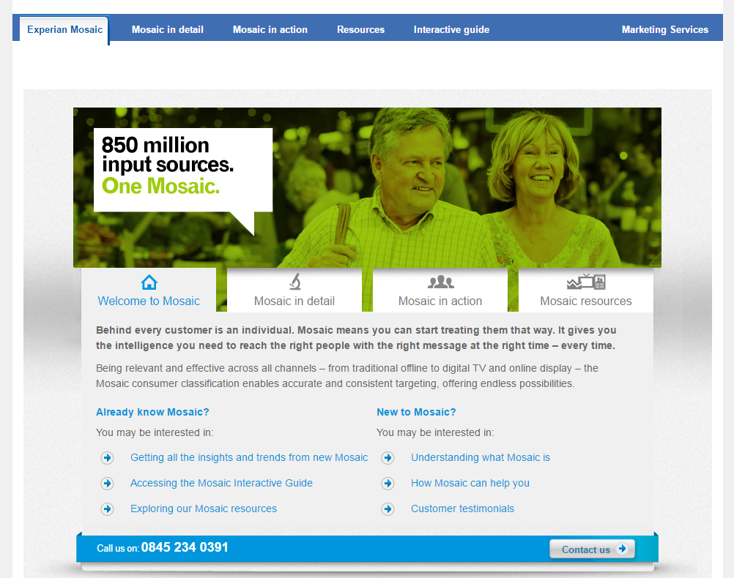
Segmenting customers: on which basis?
Overview → Segmentation → Targeting → Positioning → Recap
What is it → How is it done
Notes:
Marketers rarely limit their segmentation analysis to only one or a few variables. Rather, they often use multiple segmentation bases in an effort to identify smaller, better defined target groups. Several business information services like Experian provide multivariable segmentation systems that merge geographic, demographic, lifestyle, and behavioral data to help companies segment their markets down to zip codes, neighborhoods, and even households.
One of the leading consumer segmentation systems is Experian’s Mosaic USA system. Mosaic USA segments carry exotic names such as Birkenstocks and Beemers, Bohemian Groove, Sports Utility Families, Colleges and Cafes, Hispanic Harmony, Rolling the Dice, Small Town Shallow Pockets, and True Grit Americans. Such colorful names help bring the segments to life.
Mosaic USA can help marketers to segment people and locations into marketable groups of like-minded consumers. Each segment has its own pattern of likes, dislikes, lifestyles, and purchase behaviors.
Such rich segmentation provides a powerful tool for marketers of all kinds. It can help companies identify and better understand key customer segments, reach them more efficiently, and tailor market offerings and messages to their specific needs.

Slide 16
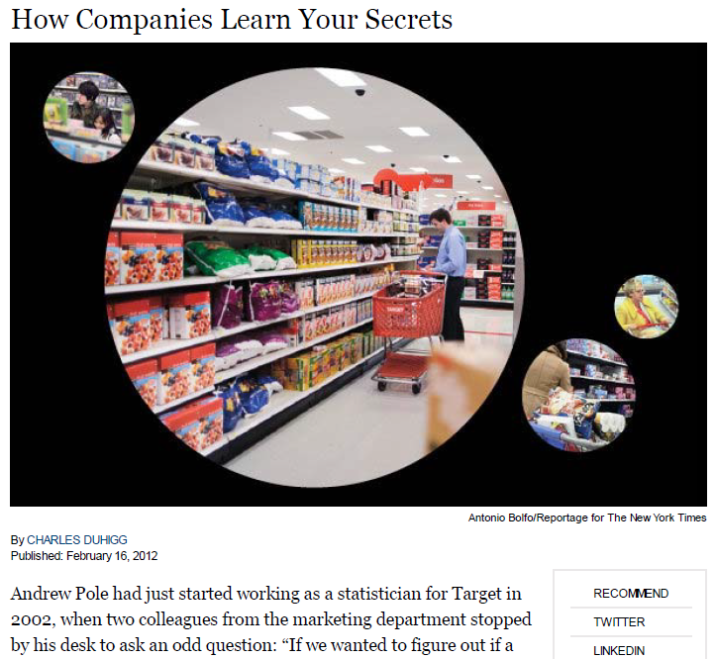
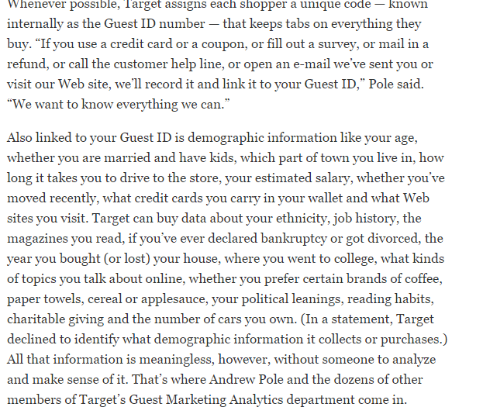
Overview → Segmentation → Targeting → Positioning → Recap
What is it → How is it done

Slide 17
Segmentation: Criteria
Measurable
Accessible
Substantial
Differentiable
Actionable
Overview → Segmentation → Targeting → Positioning → Recap
What is it → How is it done
Notes:
Measurable: The size, purchasing power, and profiles of the segments can be measured.
Accessible: The market segments can be effectively reached and served.
Substantial: The market segments are large or profitable enough to serve.
Differentiable: The segments are conceptually distinguishable and respond differently to different marketing mix elements and programs.
Actionable: Effective programs can be designed for attracting and serving the segments.

Slide 18
Targeting
Q: What is it?
A: Evaluating the attractiveness of each segment, based on
Opportunities for profit
Competitive profile
Fit with company
Based on this evaluation, selecting one or more to focus on
Overview → Segmentation → Targeting → Positioning → Recap
What is it → How is it done → Why is it done

Slide 19
Targeting
Create an Index
Weights for each criterion
Rate each segment on each criterion
Combine (i.e., weights x ratings)
For example: GE/McKinsey model
Market Opportunities for Profit:
Segment Size
Growth rate/potential
Target
Market
Selection
Company “Fit”
With Objectives
With Competencies
With Customer Base
With Resources
Competitive Intensity
Underserved Needs?
Competitors’ Strengths
Overview → Segmentation → Targeting → Positioning → Recap
What is it → How is it done → Why is it done
Notes:
https://www.strategicmanagementinsight.com/tools/ge-mckinsey-matrix.html
A target market is a set of buyers who share common needs or characteristics that the company decides to serve.
After dividing the market into segments, it’s time to answer that first seemingly simple marketing strategy question we raised: Which customers will the company serve?
The firm now has to decide how many and which segments it can serve best. We now look at how companies evaluate and select target segments.
Selecting segments that have the right size and growth characteristics is a relative matter. The largest, fastest-growing segments are not always the most attractive ones for every company. Smaller companies may target segments that are smaller and less attractive, in an absolute sense, but that are potentially more profitable for them.
Structural factors that affect long-run segment attractiveness include strong and aggressive competitors, new entrants, substitute products, power of buyers relative to sellers, and powerful suppliers who can control prices, quality, or quantity of ordered goods and services.
Some attractive segments can be dismissed quickly because they do not mesh with the company’s long-run objectives. Or the company may lack the skills and resources needed to succeed in an attractive segment. A company should only enter segments in which it can create superior customer value and gain advantages over its competitors.

Slide 20
Targeting: Why?
Undifferentiated marketing targets the whole market with one offer.
Mass marketing
Focuses on common needs rather than what’s different
Differentiated marketing targets several different market segments and designs separate offers for each.
Goal is to achieve higher sales and stronger position
More expensive than undifferentiated marketing
Overview → Segmentation → Targeting → Positioning → Recap
What is it → How is it done → Why is it done
Notes:
With undifferentiated marketing (or mass marketing), the company designs a product and a marketing program that will appeal to the largest number of buyers.
As noted in the chapter, most modern marketers have strong doubts about this strategy. Difficulties arise in developing a product or brand that will satisfy all consumers. Moreover, mass marketers often have trouble competing with more-focused firms that do a better job of satisfying the needs of specific segments and niches.
P&G markets six different laundry detergent brands in the United States, which compete with each other on supermarket shelves. Then, P&G further segments each brand to serve even narrower niches.

Slide 21
Targeting: Why?
Perceptual map
What goes on the axes?
Age
Income
Address
Socio economic
Porsche
Mercedes
Income $
Ford
Used cars
Overview → Segmentation → Targeting → Positioning → Recap
What is it → How is it done → Why is it done
Age

Slide 22
Positioning
Q: What is it?
A: The way a product is defined by consumers on important attributes
A: The complex set of perceptions, impressions, and feelings that consumers have for the product compared with competing products
May be different for each target segment
Based on a value proposition that must be different from (differentiated from) competitors
Overview → Segmentation → Targeting → Positioning → Recap
What is it → Differentiation → How is it done → Perceptual maps

Slide 23
Positioning and differentiation
Competitive advantage is an advantage over competitors gained by offering consumers greater value, either through lower prices or by providing more benefits that justify higher prices.
Possible competitive advantages to differentiate in terms of:
Product
Services
Channels (means of distribution)
People
Image
Overview → Segmentation → Targeting → Positioning → Recap
What is it → Differentiation → How is it done → Perceptual maps

Slide 24
Positioning and differentiation
Choosing the right competitive advantage:
A difference to promote should be
Distinctive
Superior
Communicable
Preemptive
Affordable
Profitable
Important
Overview → Segmentation → Targeting → Positioning → Recap
What is it → Differentiation → How is it done → Perceptual maps

Slide 25
Positioning statement
To customers who are (target summary)
Our product offers (state what the product does from the consumers’ point of view)
Relative to (competitive alternatives)
Because (reason to believe)
“For World Wide Web users who enjoy books, Amazon.com is a retail bookseller that provides instant access to over 1.1 million books. Unlike traditional book retailers, Amazon.com provides a combination of extraordinary convenience, low prices, and comprehensive selection.” (Winer, 2000, p. 64)
Overview → Segmentation → Targeting → Positioning → Recap
What is it → Differentiation → How is it done → Perceptual maps

Slide 26
Positioning: Methods
Select target segment
Determine relevant competitive offerings
Determine potential differentiator-dimensions
Select sample of customers in target segment and get ratings of competitors on selected dimensions
“View” the results (perceptual maps)
Relate to preference, choice, or market share (preference maps)
Develop positioning statement and associated strategies
Overview → Segmentation → Targeting → Positioning → Recap
What is it → Differentiation → How is it done → Perceptual maps

Slide 27
A general example: The raw data (brand ratings)
Brand | Deodorant Rating | Moisturizing Rating
Dove | 2 | 9
Oil of Olay | 3 | 8
Nivea | 3 | 2
Irish Spring | 4 | 5.5
Old Spice | 7 | 6
Overview → Segmentation → Targeting → Positioning → Recap
What is it → Differentiation → How is it done → Perceptual maps
Notes:
This slide relates to material on pp. 71-73.
: Indicates place where slide “builds” to include the corresponding point.
:
:
:
:

Slide 28
A general example: Positioning maps (brand ratings)
Greater the Similarity => Less the Distance
High moisturizing
Dove
Oil of Olay
Nivea
Nondeodorant
Deodorant
Irish Spring
Old Spice
low moisturizing
Overview → Segmentation → Targeting → Positioning → Recap
What is it → Differentiation → How is it done → Perceptual maps
Notes:
Summary Overview
This diagram shows output of a computer program that does positioning analysis.
Key Issues
Consumers have provided information about their perceptions of different brands of bar soap. The computer program has determined that there are two attributes of soap that account for the greatest difference in consumer perceptions: a.) the degree to which the soap is a deodorant soap; and b.) the degree to which the soap is a moisturizing soap.
The closer that any two dots are to each other, the more similar those brands are in the minds of consumers. Lifebuoy and Dial are in close proximity to each other because they are both low moisturizing, deodorant soaps.
Each segment may have its own preferences. The circles refer to the size of market attracted to a combination of attributes.
Positioning may also lead to combining instead of segmenting, if a firm can successfully appeal to several segments with the same product.
Therefore, positioning studies can be part of a broader analysis because they: a.) identify important attributes of the product offerings in a market; b.) identify what offerings are likely to appeal to segments; and c.) provide a basis for changing the marketing mix, should a marketer decide to reposition a product.
This slide relates to material on pp. 71-73.
: Indicates place where slide “builds” to include the corresponding point.
:
:
:
:

Slide 29
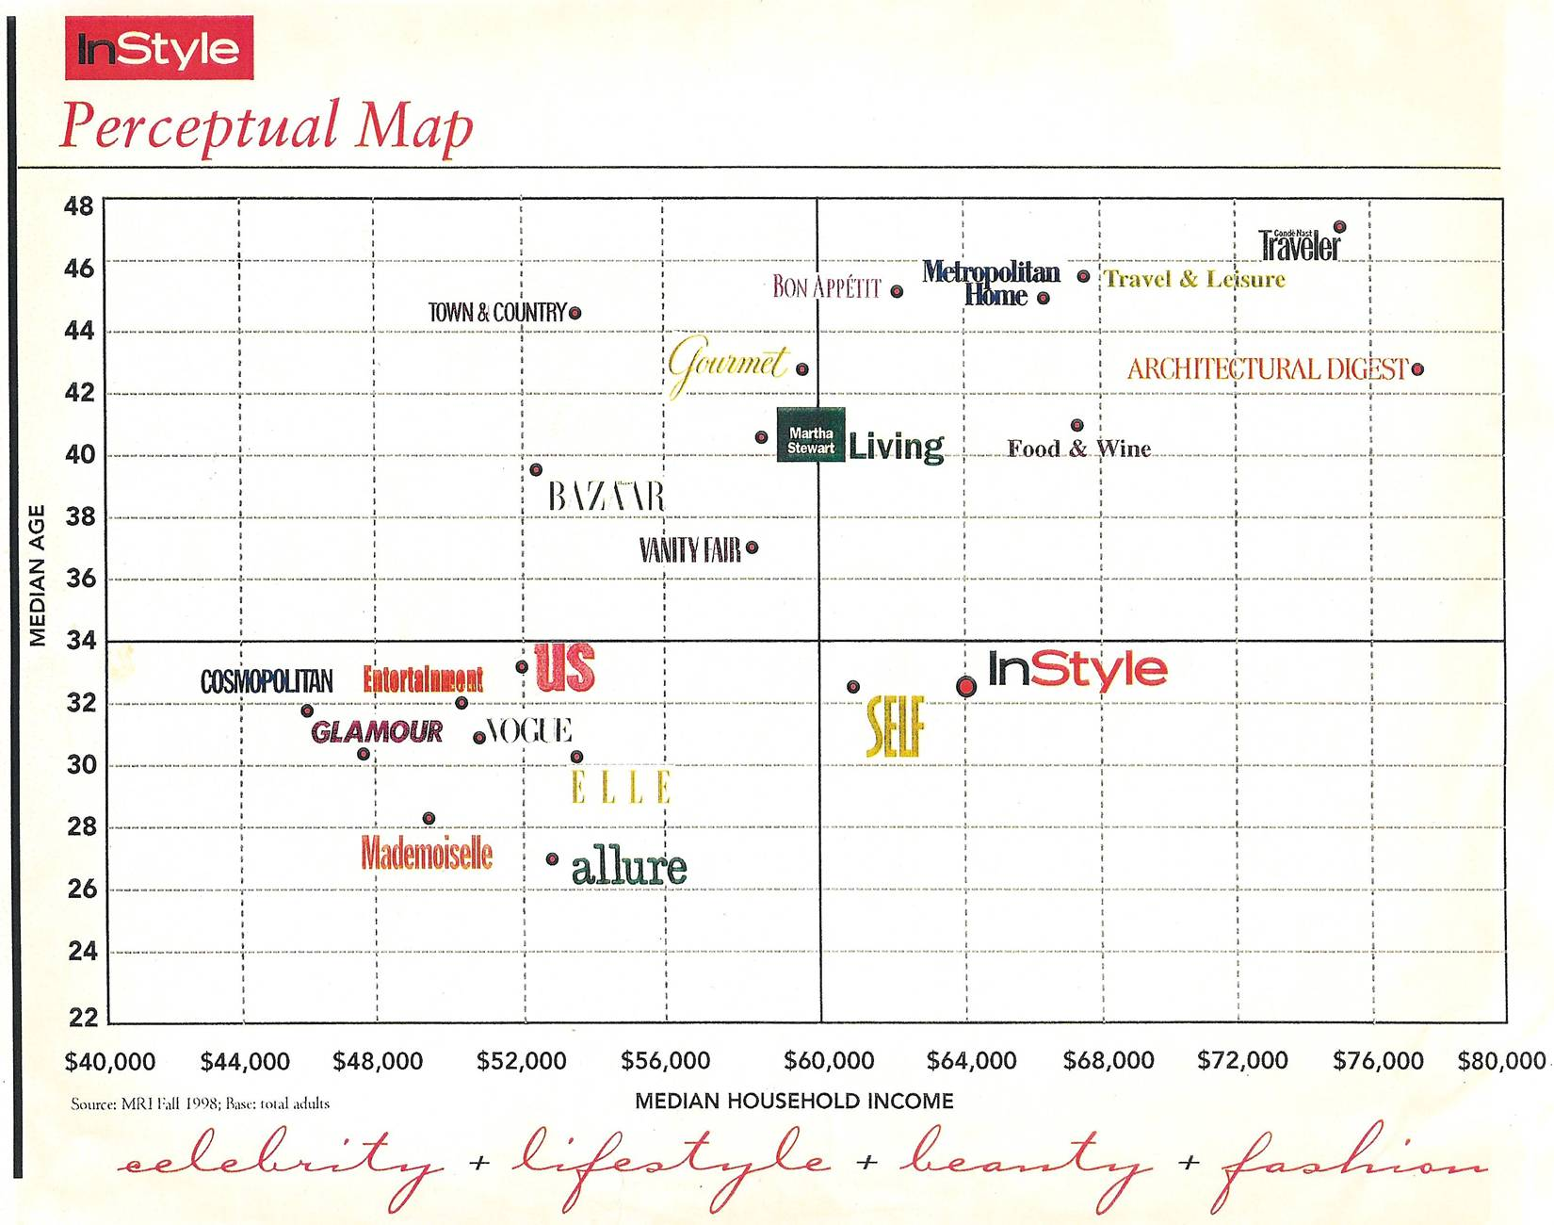
Overview → Segmentation → Targeting → Positioning → Recap
What is it → Differentiation → How is it done → Perceptual maps

Slide 30
Strategic uses of perceptual maps
Understanding the market structure
Do we have the desired position?
Are there any “holes” in the product space?
Are there any competitor vulnerabilities?
Perceptions of a new product concept
Direct R&D to satisfy customers better
Maps yield “ideal points”
Evolution of “ideal points” over time
Overview → Segmentation → Targeting → Positioning → Recap
What is it → Differentiation → How is it done → Perceptual maps

Slide 31
Recap
Next 4 weeks: Implementing the positioning using the marketing mix (“the 4 Ps”)
Overview → Segmentation → Targeting → Positioning → Recap

